Slide 1
VAS-European Independent Foundation in Angiology/Vascular Medicine Short VAS presentation in slides
www.vas-int.net

Slide 2
European Working Grounp
on Medical Angiology
1991
-Vascular-Independent Research and Education-European Organization-
1998
European Independent Foundation
in Angiology/Vascular Medicine
2018
Recognised by IUA as Angiology Committee
UEMS Division of Angiology/Vascular Medicine
(2000)→2007

Slide 3
Aims and main Activities
European Educational Projects
Equity, Quality, Harmonization in Education and Training of Specialists, MD and Health Personnel in Europe
European Collaborative
Research Projects
Equity and Independence in European Research
Prevention and Awareness (eg Calls : No More Vascular Amputations! and No more Venous Ulcers!)
Ethics, Equity and Quality in the Health Offer for Patients and Population
In Europe
Recognition of Angiology/Vascular Medicine in Europe
as a Specialty and Accreditation of Centres and Specialits

Slide 4
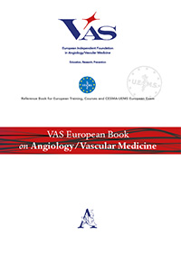
European Collaborative Independent Education and Training
Publishing Educational Papers
EACCME
EACCME Credits
Academic European Postgraduate E-Learning (1 yr)
European EACCME E-Learning Courses
European Training Fellowship
European Postgrad &Master (2 yrs)
(Academic- to be enlarged/EACCME?)
European E-Learning Platform
-VAS Campus-
EACCME Accr. requested
VAS European /International Teaching Pannel

Slide 5
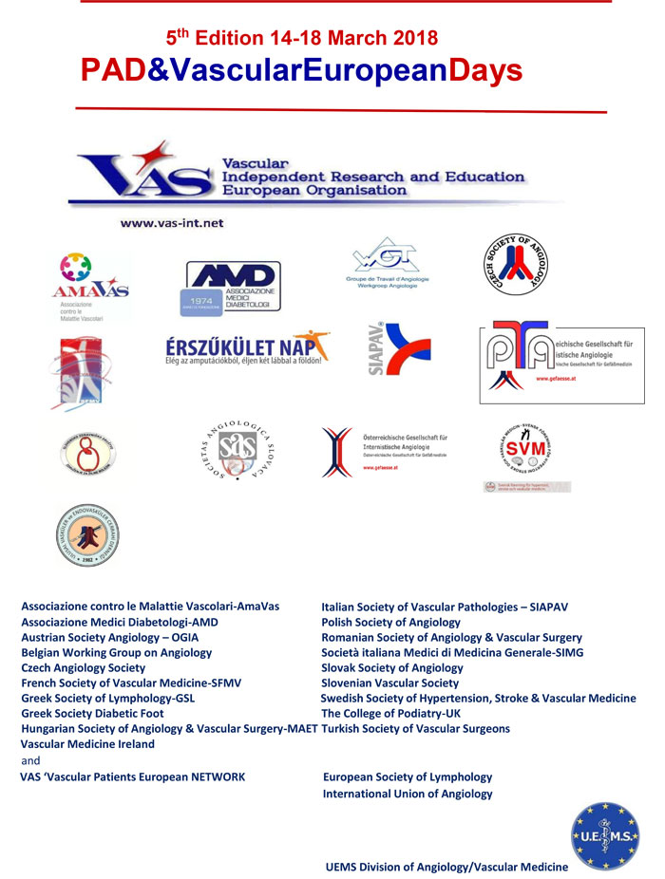
European Research and Awareness
European Research Projects
Published Projects (CLIPS, Thrombin generation ..)
Ongoing (PAD-H, collaborative projects)
VAS European Biobank (BBMRI Partner)
Awareness
VAS–Vascular Patients European Network

Slide 6
European Accreditation of Angiology/Vascular Medicine
UEMS Division of Angiology/Vascular Medicine
UEMS ETR Document for Angiology/Vascular Medicine
Accreditation for Centres:
VAS European Training Centres Validation Committee
VAS Referee Centres
&
for UEMS Accreditation
European Certification for MD
CESMA-UEMS Exam for the UEMS European Diploma
European Fellowship of Excellence (EFE-VAS)
And
European Training Fellowship (ETF-VAS)
&

Slide 7
Open Collaborative Independent Organization
VAS International Consortium
University Formal Agreements
European, International , National Societes and Organizations- Agreements
International Networks
UEMS Division Agreement
UEMS
EACCME, CESMA
UEMS EACCME COI WG
Stable collaboration with Institutions
VAS Partner of EPHA
VAS-SVM
Privileged Partnership
EU-USA
VAS-ESL
Privileged Partnership
VAS-ESM
Privileged Partnership

Slide 8
A Robust European Foundation based on
Quality/Independence /Collaboration
VAS Foundation Statute
VAS Ethical Commitments Publication
VAS Bodies:
VAS Board
Ethic&Guarantors Comm
VAS Advisory Board
Education
Research
Awareness
Writing
ETC Validation
VasYoung
VAS-IC &
Int.Networks
Partnerships
Committees
Biobank
Several Teams & WGs
Note : in pink Bodies with special organization

Slide 9
International Networks
International PAD Strategic Network
International Network on Vascular Medicine/Angiology

Slide 10
VAS Board
M. Catalano IT- VAS President
MP Colgan IRL
K. Farkas HU
B. Fazeli IRN
FGR. Fowkes UK
G. Gerotziafas FR
D. Olinic RO
Z. Pecvarady HU
JC. Wautrecht BE

Slide 11
VAS Headquarters
VAS Headquarters: c/o Research Center on Vascular Diseases and Angiology Unit-University of Milan-L.Sacco Hospital via G.B.Grassi 74-20157 Milan (Italy). Phone: +39-02-50319813 /7/2 Email: vas@unimi.it

