Slide 1
VAS-European Independent Foundation in Angiology/Vascular Medicine
Short VAS presentation in slides
www.vas-int.net

Slide 2



European Working Grounp
on Medical Angiology
1991
-Vascular-Independent Research and Education-European Organization-
1998
European Independent Foundation
in Angiology/Vascular Medicine
2018
Recognised by IUA as Angiology Committee
UEMS Division of Angiology/Vascular Medicine
(2000)→2007

Slide 3
Aims and main Activities
European Educational Projects
Equity, Quality, Harmonization in Education and Training of Specialists, MD and Health Personnel in Europe
European Collaborative
Research Projects
Equity and Independence in European Research
Prevention and Awareness (eg Calls : No More Vascular Amputations! and No more Venous Ulcers!)
Ethics, Equity and Quality in the Health Offer for Patients and Population
In Europe
Recognition of Angiology/Vascular Medicine in Europe
as a Specialty and Accreditation of Centres and Specialits

Slide 4

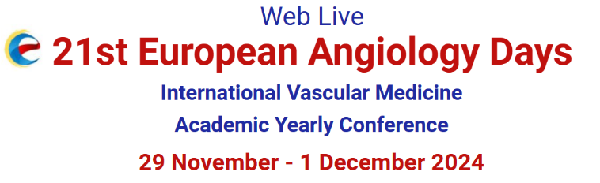

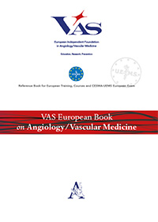
European Collaborative Independent Education and Training
Publishing Educational Papers
EACCME
+
European Postgrad &European Master
(Modular 1+1 years )
EACCME Credits
European EACCME E-Learning Courses
European Training Fellowship
European short Postgraduate E-Learning Courses
European Vascular Ultrasounds Course
European E-Learning Platform
-VAS Campus-
EACCME Accr. requested
VAS International Academy- European Teaching Pannel
+
Eu Reference Centres of Excellence
New EDITION IN 2025
Springer Publisher

Slide 5
European Collaborative Independent Education and Training
VAS International Academy-
  -European Teaching Panel
  -European Referee Centres of Excellence
VAS Campus Accredited Platform

Slide 6

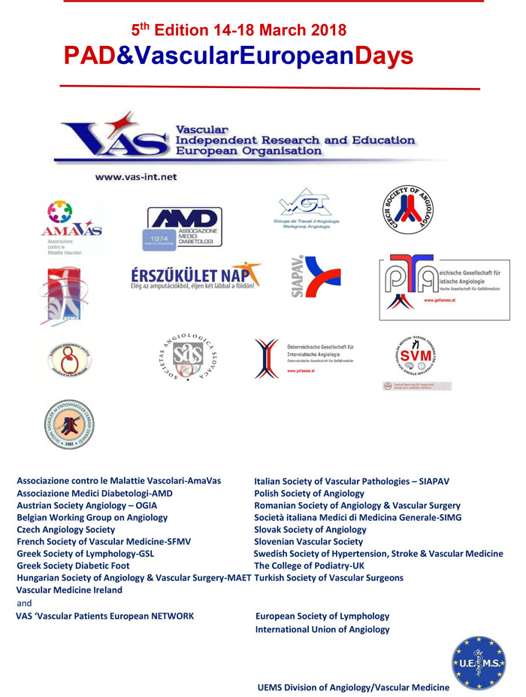
European Research and Awareness
European Research Projects
Published Projects (CLIPS, Thrombin generation ..)
Ongoing (PAD-H, collaborative projects)
VAS International Networks
Awareness
VAS–Vascular Patients European Network

Slide 7
European Accreditation of Angiology/Vascular Medicine
UEMS Division of Angiology/Vascular Medicine
UEMS ETR Document for Angiology/Vascular Medicine
VAS International Academy
Vascular Medicine
VAS European Teaching Pannel
Accreditation for Centres:
VAS European Training Centres Validation Committee
VAS Referee Centres of Excellence
&
for UEMS Accreditation
European Certification for MD
CESMA-UEMS Exam for the UEMS European Diploma
European Fellowship of Excellence (EFE-VAS)
And
European Training Fellowship (ETF-VAS)
&

Slide 8
Open Collaborative Independent Organization
VAS International Consortium
University Formal Agreements
European, International , National Societes and Organizations- Agreements
International Networks
UEMS Division
UEMS-VAS MoU
UEMS
CESMA
Stable collaboration with Institutions
VAS Partner of EPHA
VAS Accredited NSA Partner by WHO
VAS-SVM
Privileged Partnership
EU-USA
VAS-ESL
Privileged Partnership
VAS-ESM
Privileged Partnership

Slide 9
A Robust European Foundation based on
Quality/Independence /Collaboration
VAS Foundation Statute
VAS Ethical Commitments Publication
VAS Bodies:
VAS Board
Ethic&Guarantors Comm
VAS Advisory Board
Education
Research
Awareness
Writing
ETC Validation
VasYoung
VAS-IC &
Int.Networks
Partnerships
Committees
Several Teams & WGs
Note : in pink Bodies with special organization

Slide 10
International Networks
International PAD Strategic Network
International Network on Vascular Medicine/Angiology

Slide 11
VAS Board
G. Schernthaner AT – President | University of Vienna
M. Catalano IT- Honorary President and Past-President | University of Milan
MP. Colgan IRL | University of Dublin
E. Dimakakos GR | University of Athens Vascular Center
K. Farkas HU | Szent Imre Teaching Hospital Budapest
B. Fazeli IRN | Buerger Network
G. Gerotziafas FR | Sorbonne Université
M. Kozak SL | Ljubljana University Medical Centre
A. Liew IRL | University of Galway
P. Marschang IT | Central Hospital Bozen
Z. Pecsvarady HU | Flor Ferenc Hospital. Kistarcsa
S. Pillon IT | San Camillo Forlanini Hospital
M Prior IT | Verona University Hospital
A. Stanek PL | University of Silesia in Katowice
JC. Wautrecht BE | Libre University Brussels
M. Vrkic HR | University of Zagreb

Slide 12
VAS Headquarters
VAS Headquarters:
c/o Research Center on Vascular Diseases and Angiology Unit-University of Milan-L.Sacco Hospital
via G.B.Grassi 74-20157 Milan (Italy).
Phone: +39-02-50319813 /7/2
Email: vas@unimi.it

